Slide 1

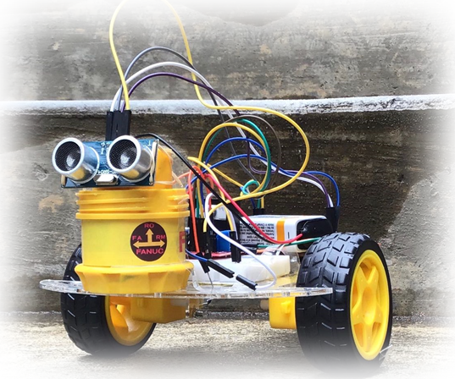
Indoor Obstacle Avoidance Patrolling Vehicle
Zhubo Zhou
Zhengyang Weng
Virtual Final Project Presentation
ME 4405 Fundamentals of Mechatronics (Spring 2020)

Slide 2
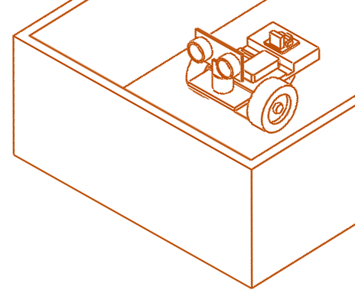
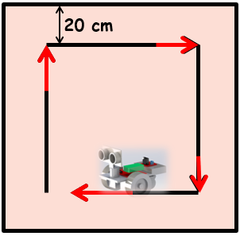
Project Motivation and Performance Goals
Goals: Build and program a smart robot car with obstacle avoidance capability, using MSP432, HC-SR04 ultrasonic sensor, 2 DC motors, and control theory
Motivations: sweeping robot, food delivery robot, warehouse robot
Performance Requirements:
  can go straight at a reasonable speed
  can consistently detect & stop at 20 ± 2 cm in front of obstacles
  can rotate 90° to the right after encountering obstacles
Limitation: well-defined indoor area (enclosed by walls)

Slide 3
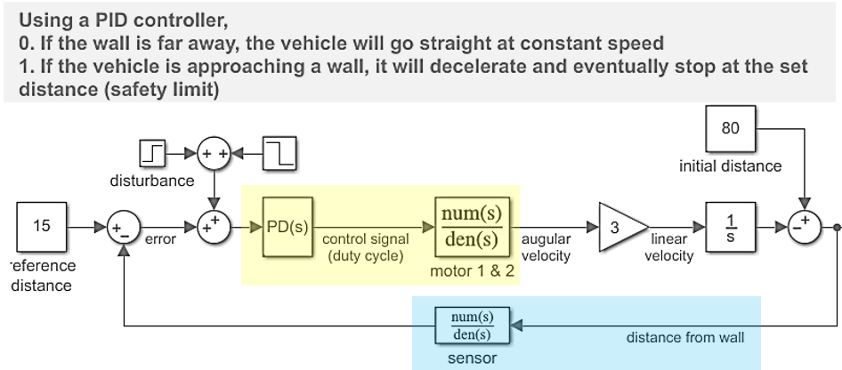
General System Block Diagram and Logic
Mode 1

Slide 4
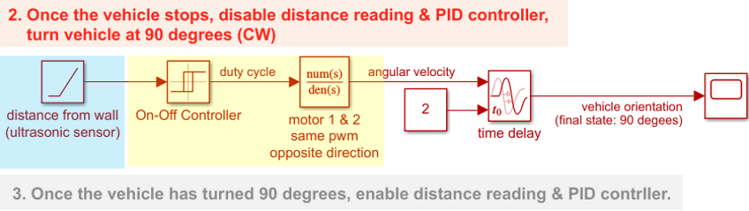
General System Block Diagram and Logic
Mode 2
<System block diagram of your choice>

Slide 6
General System Block Diagram and Logic
Robot car starts moving forward
Ultrasonic sensor sends distance readings to controller
Operating Cycle
Robot car turns right and stop at 90 degrees
PD controller allows the car to decelerate & eventually stop at 20 cm away from wall
disable distance reading & turn off DC motors

Slide 7
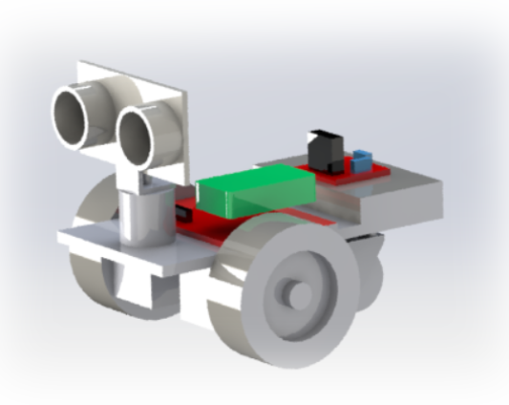
Mechanical Design

Slide 8
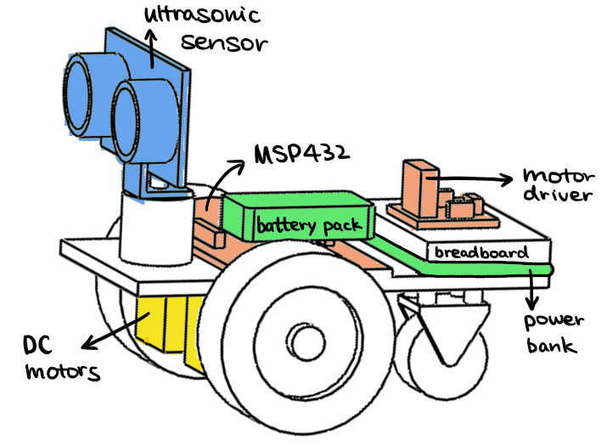
Mechanical Design: Structural Description
General System Architecture
  Chassis and Mechanisms
    Acrylic chassis
      Motor mount
      Sensor mount
      Electronics mount
      Passive universal wheel
  Primary Actuators
    Propelling brushed DC motors
      Gear reduction
  Sensors/Transducers
    HC-SR04 Ultrasonic sensor

Slide 9
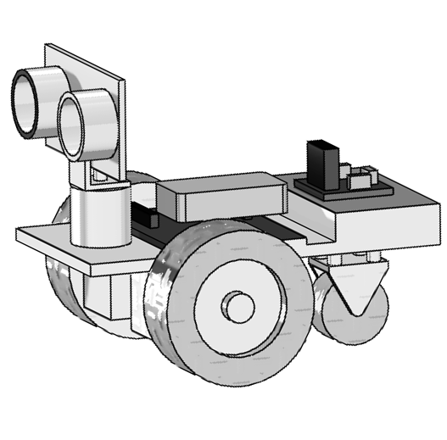
Mechanical Design: Structural Description
z
Physical Dimensions
  25cm x 16cm x 10cm
Mass and Inertia
  1.2 kg+0.3kg external battery
  Ixx = 0.0263 kg*m^2
  Iyy = 0.0539 kg*m^2
  Izz = 0.0734 kg*m^2
Design Considerations
  Compact, lightweight design due to limited motor output
  Chassis platform provides enough space for battery packs and electronics
x
y

Slide 10

Mechanical Design: System Performance
Kinematic Description
  Forward motion
    Propelled through gear reduction transmitted DC brushed motor
    1:48 gear ratio
  Rotational motion
    Achieved through reversed PWM signal
    Rotation about the center of axle

Slide 11
Mechanical Design: System Performance
Quantitative Performance Goals
  Operation Speed > 1m/s
  85°<Steering Angle <95°
  18cm<Stop Distance < 22cm

Slide 12
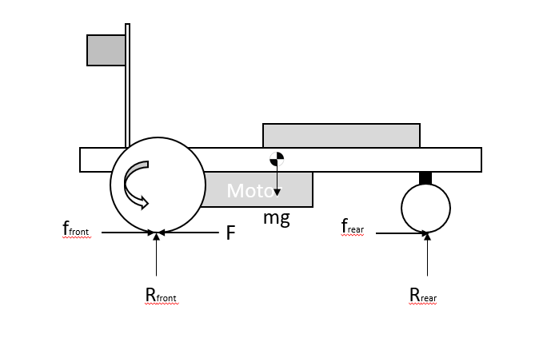
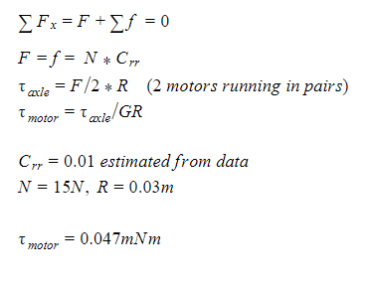
Mechanical Design: System Performance
Mechanical Model and Analysis
  Motor static output (from FBD):

Slide 13
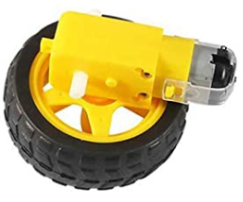
Mechanical Design: Actuator Selection Rationale
Actuator 1: DC
  Kinematic Requirements: Based on qualitative performance spec of the system
    Revolution speed: 15000 rpm
  Kinetic Requirements: Based on torque calculation of the FBD
    Torque: 0.05mNm
Estimated
Requirements
Actuator
Specifications
Spec 1
15000rpm
16500rpm
Spec 2
0.05mNm
3.125mNm

Slide 14
Electrical System and
Circuit Design

Slide 15
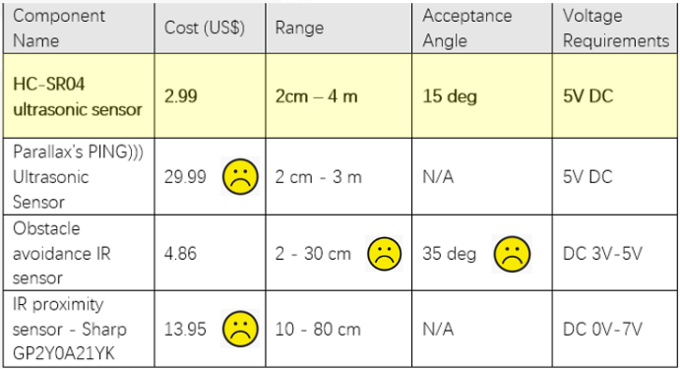
Electrical Design: Sensor Selection
Distance Sensor
Performance Goals & System Requirements
Affordable
Stop at 20 ± 2 cm away from wall
Start deceleration at 50 cm away from wall
Small acceptance angle
Sensor Specifications
Cost < $10
Range : 20 cm - 50 cm
Acceptance angle < 20 degrees

Slide 16
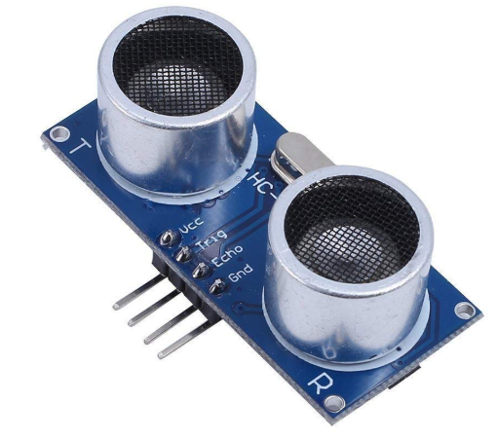
Electrical Design: Sensor Selection
Selected Sensor: HC-SR04 Ultrasonic Sensor
  Key Features and Specs
    Range: 2 cm - 400 cm
    Accuracy: 3mm
    Resolution: 1cm
    Sampling rate: 40Hz
    Communication: GPIO (trigger & echo)
    Working Voltage: DC 5 V
    Working Current: 15mA
    Acceptance Angle: 15°
Potential Sources of Noise
  Source 1: unsmooth surface
  Source 2 : acoustic noise at same frequency
  Source 3 ✅: faulty reading due to overflow/ echo from the ground
Desired Sensor Specifications
Cost < $10
Range : 20 cm - 50 cm
Acceptance angle < 20 degrees
Actual Sensor Specifications
Cost ✅: $ 2.99
Range ✅: 2 cm - 400 cm
Acceptance angle ✅: 15 degrees

Slide 17
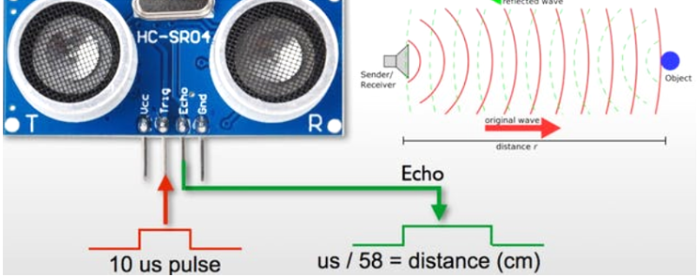
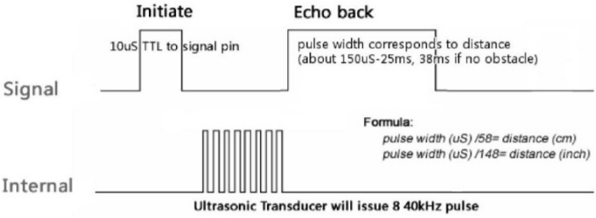
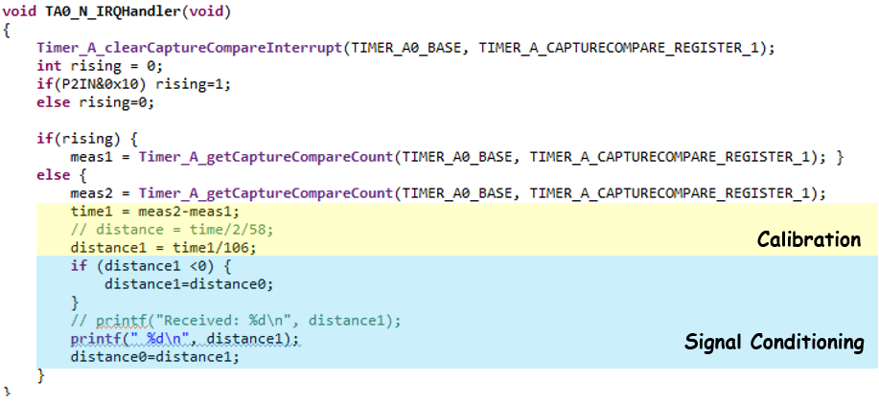
Electrical Design: Implementation on the MSP432
Major MSP432 Features Required: GPIO (digital sensor)

Slide 18
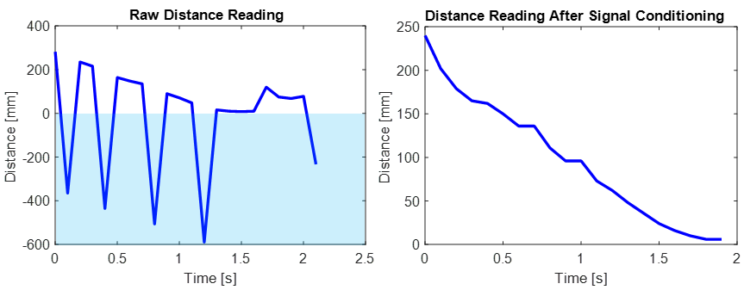


Electrical Design: Signal Conditioning
  Desired Signal: continuous & positive distance reading
  Potential Noise Source:
    reflection from ground
    data overflow (get negative values for distance reading)
      within range
      exceed max range
  Conditioning Approach:
    mount the ultrasonic sensor to a higher platform
    assuming vehicle speed is low & sampling frequency is high
current_distance = last_distance

Slide 19
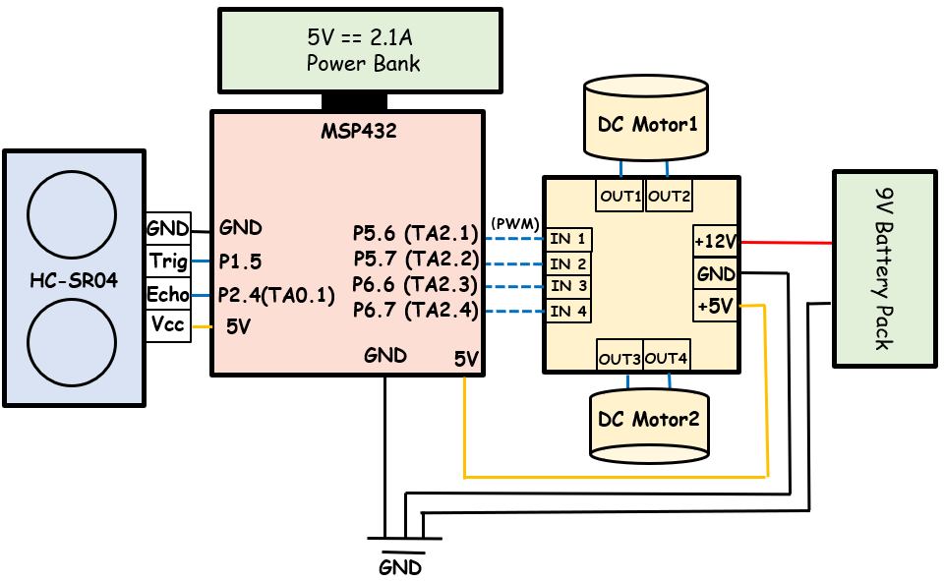
Electrical Design: System Circuit Diagram

Slide 20
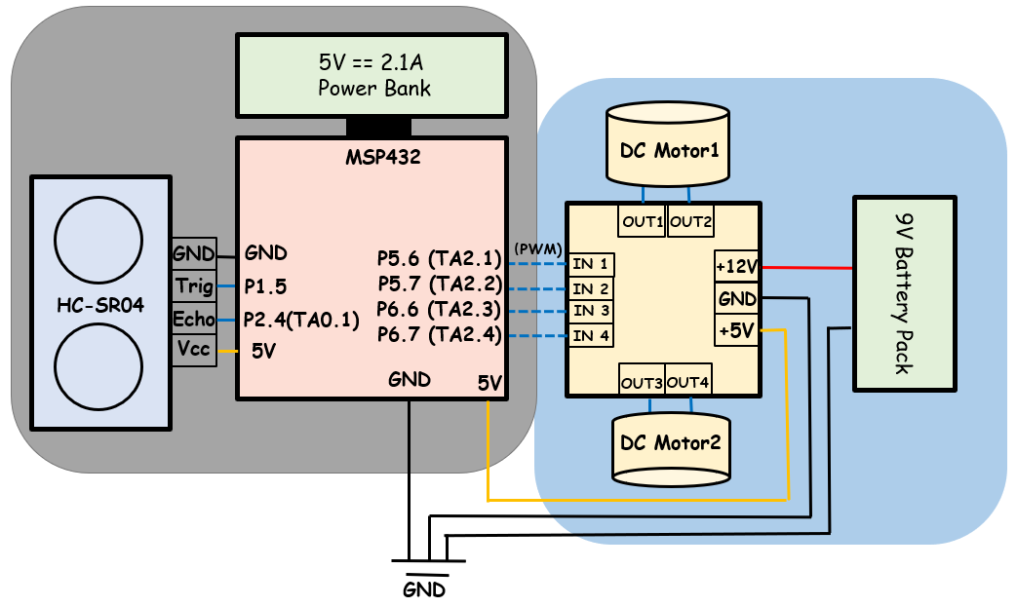
Electrical Design: Power Supply Specification
5V Portable Power Bank: Ultrasonic Sensor & MSP 432
Power Bank: Under 5V, 5000mAh = 25Wh
Power consumption by MSP: 0.1W (estimated)
Power consumption by HC-SR04: 5V * 0.01A = 0.05W
Battery life: 25Wh/(0.1+0.05W) = 166.7h
9V Battery: Motor Driver Circuit
9V Battery: Under 9V, 565mAh = 5.085Wh
Power consumption:
1.4W x 2+0.036A x 5V = 3.01W
Battery life: 5.085Wh/3.01W = 1.71h
Total Power Calculations (for one hour)
(5000mAh/166.7h)+(565mAh/1.71h) = 360.4 mAh

Slide 21
Feedback Control and Simulation

Slide 22
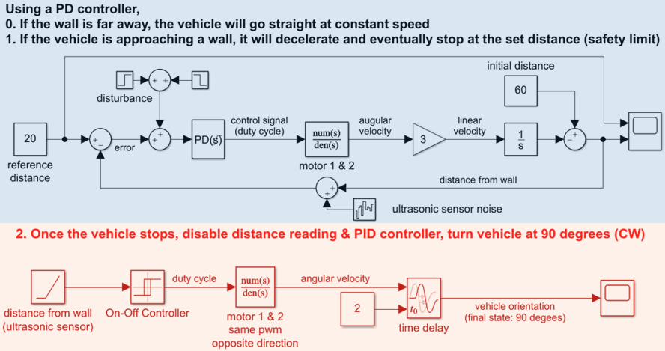
Feedback Control: System Block Diagram

Slide 23
Distance Control: Stop the Car at 20cm Away From Wall
Selected Controller for DC Motors: PD
  Proportional✅: Drive the system toward its safety limit distance
  Integral❎: Might introduce large overshoot & longer settling time
  Derivative✅: Prevent overshoot and oscillation
Gain tuning considerations
  Proportional gain K_{p}
    Too high: causes overshoot & make the system unstable
    Too low: slow system response, low tolerance to disturbance
  Derivative gain K_{d}
    Facilitate direction changes: minimize overshoot and oscillation when the car quickly slows itself or changes direction
  Controller saturation limit
    Allow the robot car to go straight at a reasonable fixed speed if obstacle is far away

Slide 24

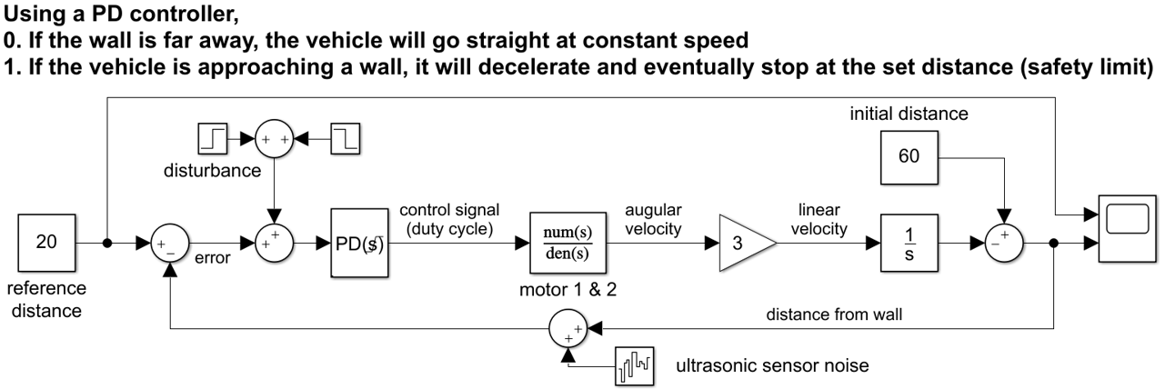
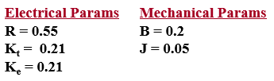
Feedback Control: Control Simulations
Block Diagram for DC Motor: Stop The Car at a Set Distance From Wall
  Simulink simulation settings
    Time Step: 0.005s
    Time Range: 80s
    Controller Saturation Limit: ± 10
    DC Motor Transfer Function:
Electrical Params
R = 0.55
K_{t} = 0.21
K_{e} = 0.21
Mechanical Params
B = 0.2
J = 0.05

Slide 25
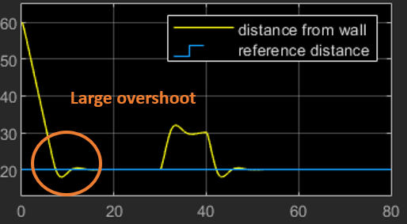
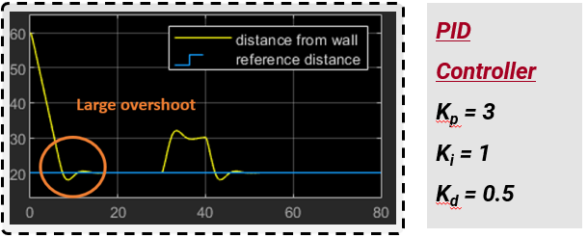
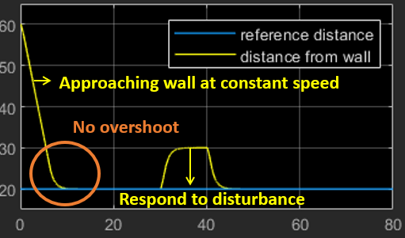
Feedback Control: Control Simulations
Results of MATLAB Simulations
  Unsuccessful Feedback Control:
the PID controller with Kp= 3, Ki= 1, and Kd= 0.5 resulted in large overshoot and some oscillation
  Successful Feedback Control:
the PD controller with Kp= 3 and Kd= 2 can stop the robot car at 20 cm away from the wall without overshoot & oscillation
<Plot of results>
PID Controller
K_{p} = 3
K_{i} = 1
K_{d} = 0.5
<Plot of results>
PD Controller
K_{p} = 3
K_{i} = 0
K_{d} = 0.5

Slide 26
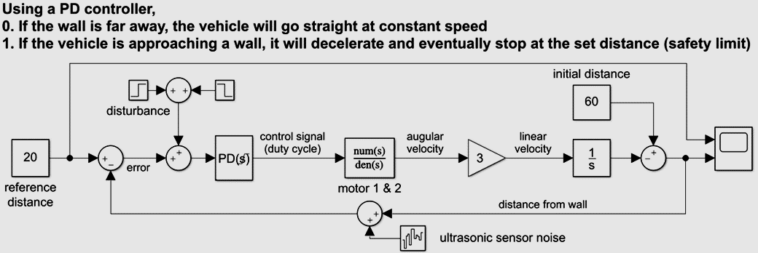
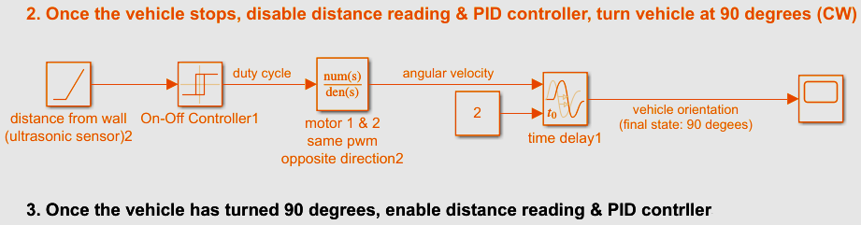

Slide 27
Code Structure for Virtual Final Project
MSP432 Processing Details
  DCO Frequency - 24MHz
  communication: digital to digital
  <Timer setup>
Timer A0, Timer 32: 24MHz - to maintain high sampling rate of the sensor
Timer A1, A2 (PWM): 3MHz - to generate PWM signal
  <interrupt>
Timer A0, Timer A1
File Hierarchy and Libraries
  <msp.h> <stdio.h> <driverlib.h> <stint.h> <FinalPIDHeader.h>
Pseudocode and custom functions
  Pseudocode
  Custom function - trigger signal delay

Slide 28
Code Structure for Virtual Final Project
Wall-Vehicle Error Distance
High-Level Pseudocode
  Signal acquisition
    Echo return from ultrasonic sensor will be counted by timer 32 to determine its length
    Conditioned signal will be used to determine operation mode
  PWM signal generation
    PWM will be generated via timer A using PD controller output
Sending Ultrasonic Trigger Signal
Generate Propelling Motor Driver Signals
PWM Signals
System Dynamics
Greater than 20cm?
10 microsecond pulse
Controller
Generate Steering Motor Driver Signals
PWM Signals
Acquire Echo Signal
Distance in cm
Timer 32 Determines the beginning and the end of the signal
Apply Sensor gain and calibration
Time Delay

Slide 29
Mechatronic System Evaluation
Description of evaluation process
Target Performance | Evaluation Methods & Metrics
straight line movement | eyeball, operation along smooth wall
can consistently detect & stop at 20 ± 2cm in front of wall | measure using ruler
can rotate 90° to the right after it has stopped in front of the wall | eyeball, continuing operation around
can resist disturbance | move the car back by 10 cm and see if it still wants to proceed & stop at 20cm away from wall

Slide 30
Challenges and Potential Improvements
Challenges and Solutions
  HC-SR04 sensor was difficult to set up
  Combining systems requiring different clocks
Potential Improvements:
  Encoder for speed and steering control
    Enables more precise control over speed and steering angle
  Servo for ultrasonic sensor rotation
    Enables movement angle recognition
  smoother sensor reading

Slide 31
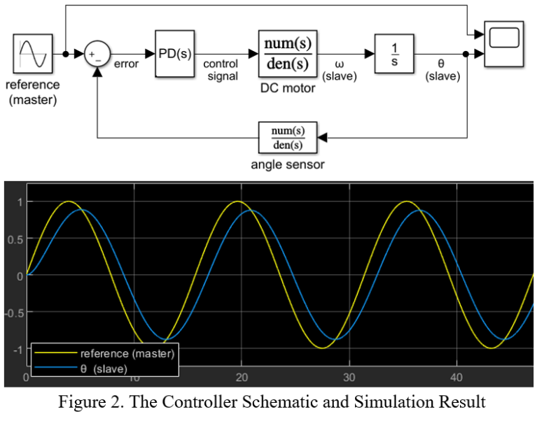
Angle (rad)
Time (s)

Slide 32
I also didn’t realize that there might be a later version in the dropbox. I edited the one you attached in your email. Hopefully there weren’t significant changes between the two versions.
Once you address the comments I made on the report, feel free to send the report to Dr. Hammond. CC me in the email and let him know that I reviewed it.
Let prof know that bryan has reviewed it
Let bryan know that there is no updated version

